Slide 1
SMART ACADEMIC PERFORMANCE PREDICTION USING STUDENT HABIT DATA USING MACHINE LEARNING
PRESENTED BY
S.VARSHINI 23UE1A7349
M.ADHINARAYANA 23UE1A7302
S.SHOHEB 23UE1A7328
T.MOUNIKA 23UE5A7318

Slide 2
AGENDA
Abstract
Introduction
Existing and Proposed System
Literature Survey
System Specifications
System Design
Modules
Screenshots
Future Scope
Conclusion

Slide 3
Abstract
The project predicts student exam scores using machine learning algorithms.
It uses factors such as study hours, sleep time, attendance, social media usage, exercise, and mental health.
The dataset is cleaned, processed, and trained using a regression model to find relationships between habits and performance.
A Tkinter GUI interface allows users to input data and instantly receive predicted exam scores..

Slide 4
Introduction
Education is important for student success, and many factors affect academic performance.
Machine learning can analyze data and identify patterns in student behavior.
This project predicts exam scores using habits like study hours, sleep, attendance, and social media usage.

Slide 5
Existing System
Student performance is evaluated mainly using exam marks, assignments, and attendance.
Teachers analyze performance manually based on marks and classroom observation.
Traditional systems do not consider lifestyle factors like sleep, study habits, and social media usage.
Because of this, it is difficult to understand the real reasons behind academic performance.

Slide 6
Proposed System
The system uses machine learning algorithms to predict student exam performance based on their daily habits.
It analyzes factors such as study hours, sleep time, attendance, social media usage, exercise, and mental health.
The dataset is processed and trained using a regression model to learn the relationship between habits and exam scores.

Slide 7
Advantages of Machine Learning in Smart Academic Performance Using Student Habit Data
Time Saving – Results are generated quickly after entering data.
Better Understanding – Shows how lifestyle habits affect academic performance.
Accurate Prediction – Machine learning improves prediction accuracy using multiple factors
User Friendly Interface – Simple GUI created using Python Tkinter.

Slide 8
Drawbacks of Machine Learning in Smart Academic Performance Using Student Habit Data
Data Dependency – Prediction accuracy depends on the quality and size of the dataset.
Limited Factors – The system may not include all real-life factors affecting student performance.
Prediction Errors – Machine learning models may sometimes produce inaccurate results.
Technical Setup – The system needs proper software and programming knowledge to run.

Slide 9
Literature Survey
Previous studies show that machine learning can effectively analyze student data to predict academic performance.
Researchers have used algorithms like Linear Regression to study the relationship between student habits and exam results.
Many studies highlight that factors such as study hours, attendance, sleep patterns, and lifestyle habits strongly influence academic success.
These research works inspired the development of systems that use student habit data to predict performance and support better academic planning.

Slide 10
System Specifications
Hardware Requirements
Processor: i3 processor or above
RAM: 4 GB or more
Hard Disk: 40 GB or higher
Software Requirements
Operating System: Windows 8 or above
Coding Language: Python
Framework: TKinter

Slide 11
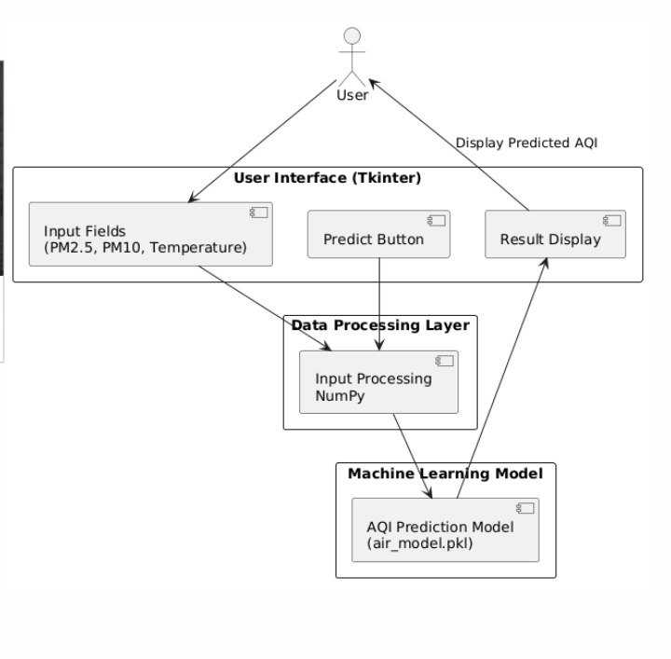
System Design
SYSTEM ARCITECTURE:

Slide 12
The diagram explains how we predict Academic performance using student habit data by looking at many things:
User Input – The user enters student habits like study hours, sleep time, and attendance in the Tkinter interface.
Data Processing – The input data is processed using NumPy.
Machine Learning Model – The processed data is sent to the trained ML model.
Prediction – The model analyzes the habits and predicts the exam score.
Result Display – The predicted score is shown in the result display of the GUI.

Slide 13
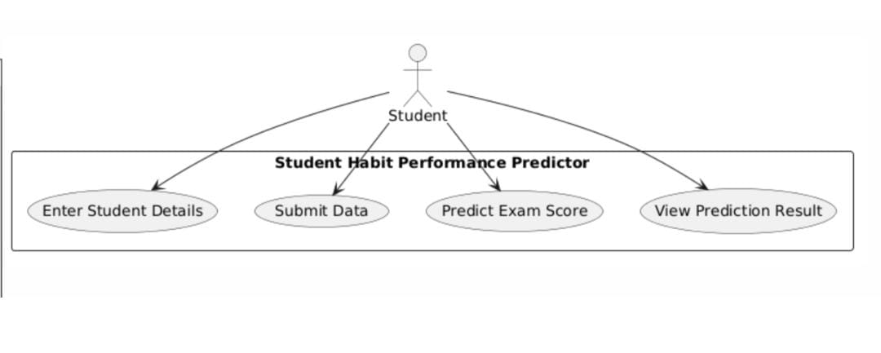
Uml Diagrams Usecase Diagram

Slide 14
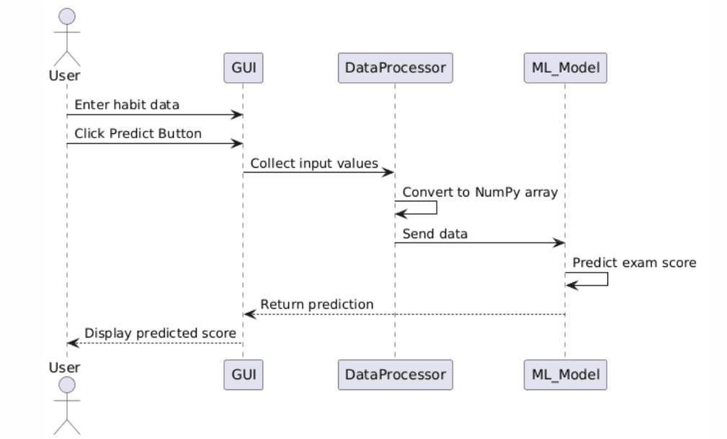
Sequence Diagram

Slide 15
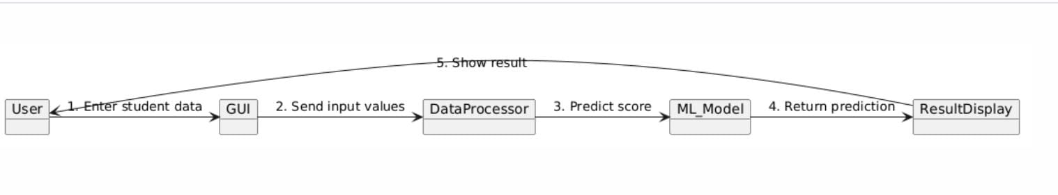
Collabration Diagram

Slide 16
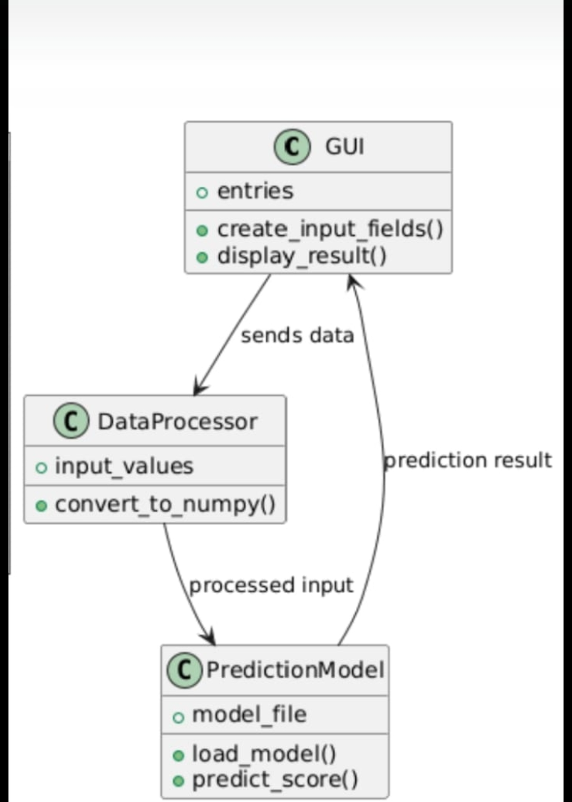
Class Diagram

Slide 17
Modules
1)Login Page
2)Home Page
3)Predicate Output

Slide 18

ScreenShots
Login Page

Slide 19
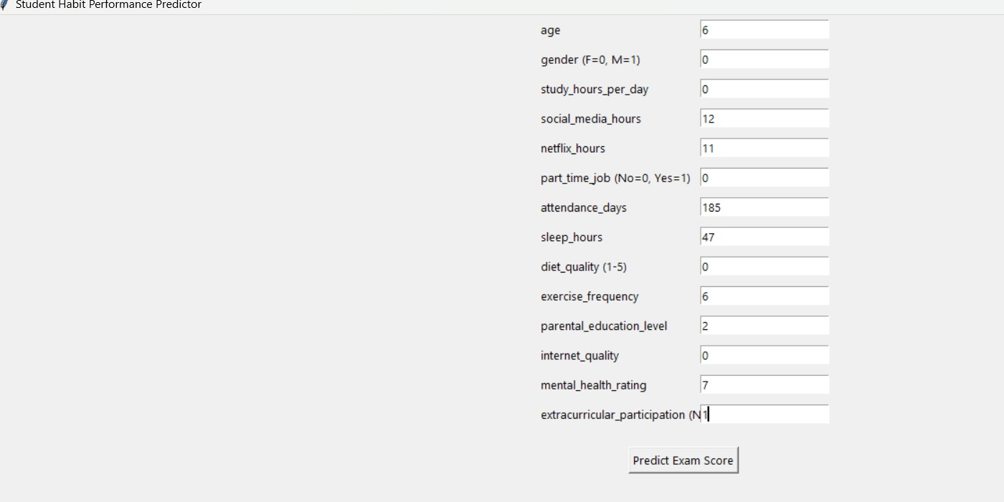
Home Page

Slide 20
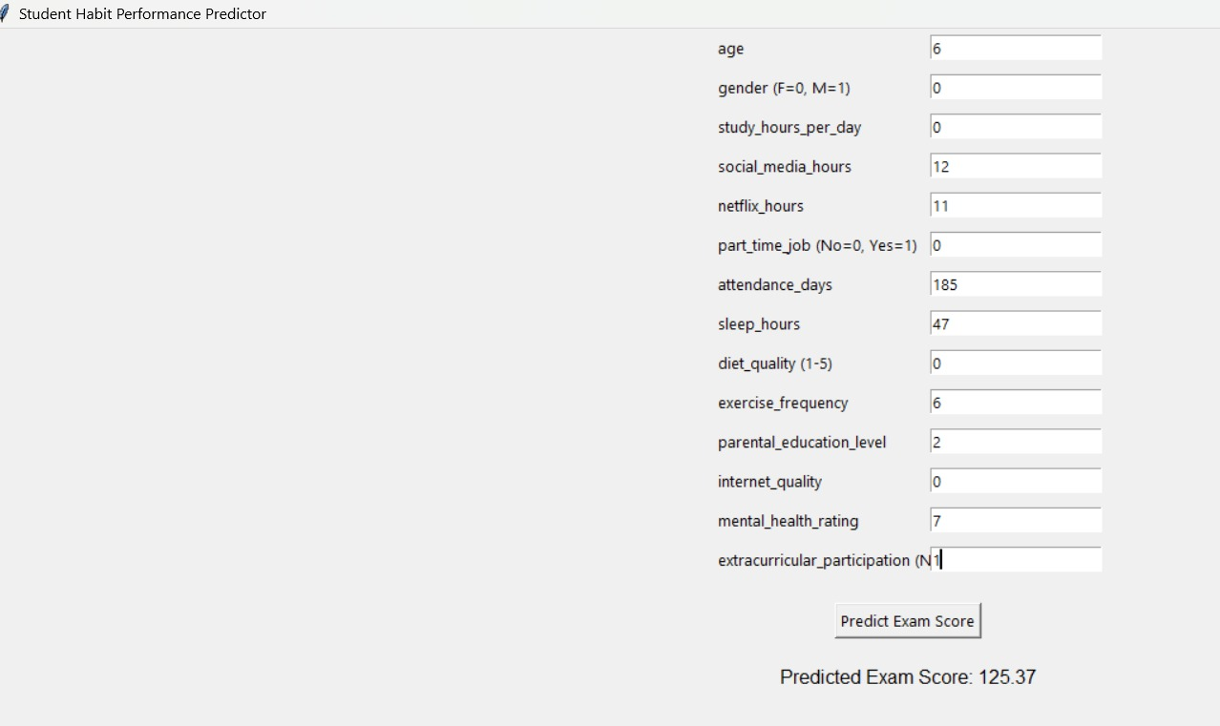
Output Data

Slide 21
Future Scope
The system can be improved by using larger and real-time student datasets for better prediction accuracy.
Advanced machine learning or deep learning models can be implemented to improve performance.
The system can be developed into a web or mobile application for easier access.
It can also provide personalized study suggestions to help students improve their performance.

Slide 22
Conclusion
This project demonstrates how machine learning can be used to predict student academic performance.
It analyzes different factors like study habits, sleep, and attendance that influence exam results.
The Tkinter-based interface makes the system simple and user-friendly.
With further improvements and more data, this system can help students and teachers improve learning outcomes.

Slide 23
THANK YOU

